Slide 1

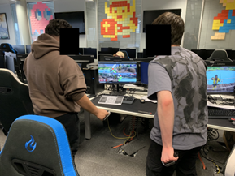
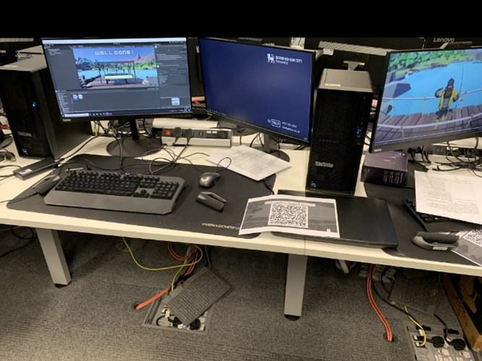
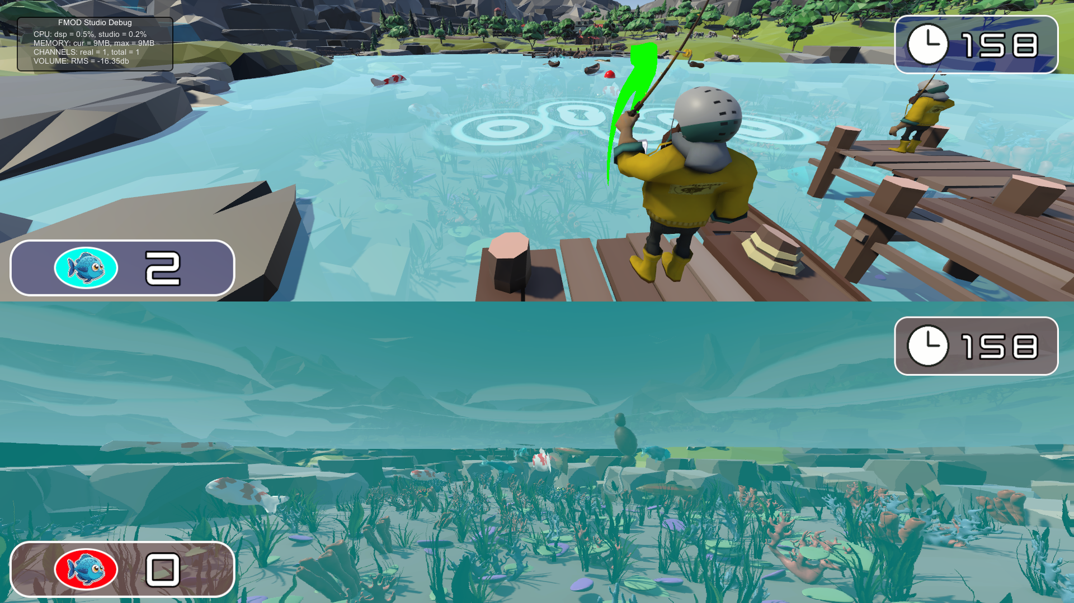
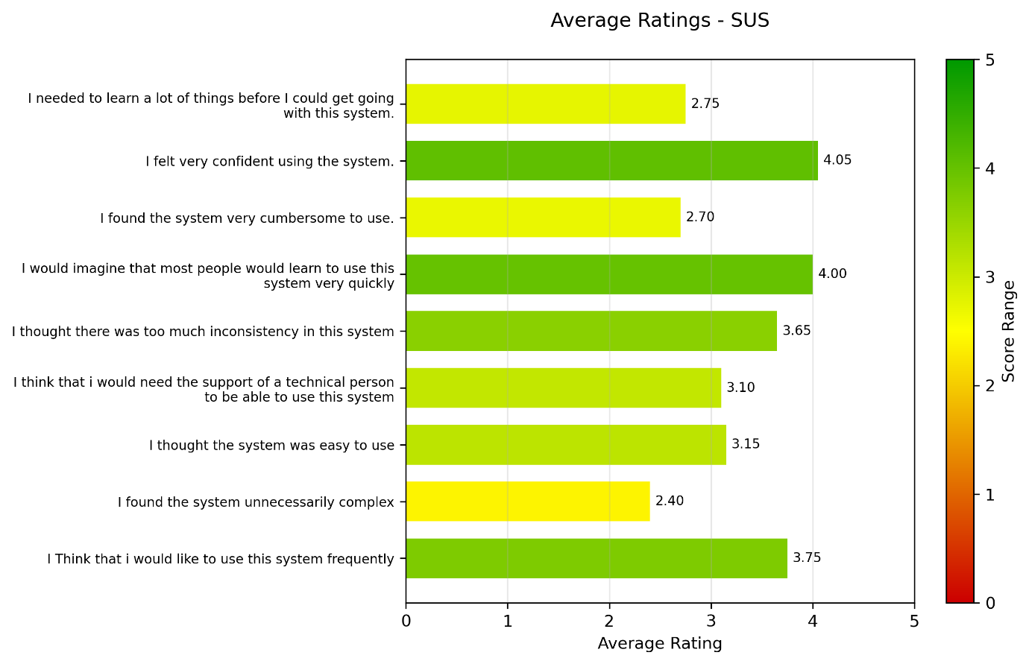
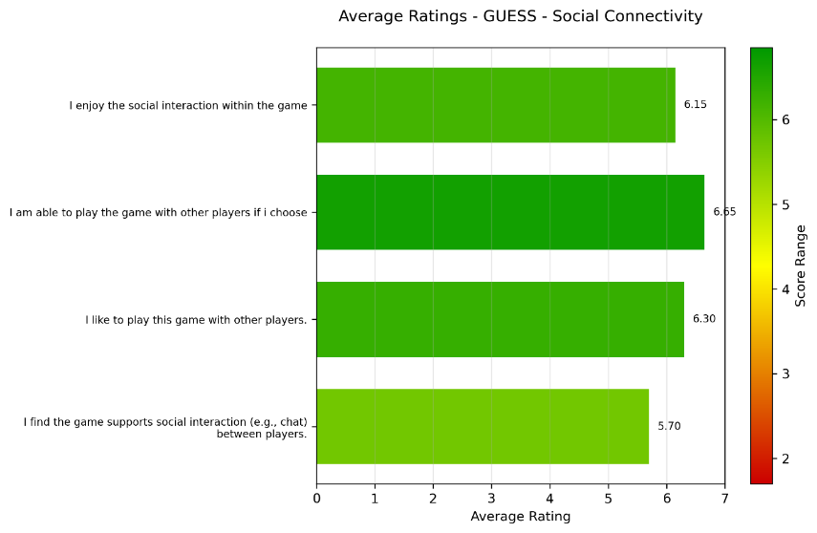
DESIGN AND IMPLEMENT A MULTIPLAYER DIGITAL
GAME FOR UPPER LIMB STROKE REHABILITATION
James Bland
2214284
Introduction
This project covers the research, development and testing of a multiplayer video game designed to be used in an upper limb stroke rehabilitation setting. This is a preliminary test where player enjoyment will be the key metric.
Literature Review
Key game design elements essential for effective gamified rehabilitation were identified: meaningful play, intuitive interaction, motivational rewards, and social features like multiplayer. Studies show that multiplayer or social elements can significantly enhance user motivation and satisfaction, particularly with the growing comfort in virtual communication. Visually engaging environments and feedback mechanisms, such as synchronized limb movements and haptic responses, further support therapy effectiveness. Games targeting both gross and fine motor skills are favored, with most existing solutions focusing on small, standalone games. Based on these findings, the project proposes a fishing game requiring upper limb (UL) movements for gameplay, supporting both single and multiplayer modes in a visually stimulating environment.
Implementation
Testing
The project was developed using an Agile methodology split into two sprints. Sprint 1 involved creating a prototype for early testing. Following this pilot tests were initiated. Sprint 2 focused on integrating feedback, integrating multiplayer finalizing features, and adding polish such as UI, art, and sound.
The game was built in Unity. Each player follows a gameplay pipeline composed of small tasks.
These features were guided by design decisions rooted in the literature review, ensuring that gameplay facilitated rehabilitation through engaging and purposeful motion
Twenty participants (mostly male, aged 18–24) tested both single and multiplayer modes in a controlled environment. They played while standing to simulate a therapeutic context and completed pre- and post-play questionnaires.
Results
Results showed high ratings in enjoyment, engagement, and social connectivity. Usability scored well but highlighted areas for improvement, such as more intuitive UI controls. Overall, the game was effective in promoting upper limb use and player motivation, validating its core design choices.
Conclusions
This preliminary study informed the design of a gamified system to encourage beneficial upper limb movements for stroke rehabilitation. Tested on adults, the game was found to be usable, motivating, and effective in promoting arm use, with multiplayer features notably enhancing enjoyment and suggesting potential for further research.
Further Recommendations
Future development should improve the accessibility and ease of use of the game. Increasing the suitability of the game to stroke patients by addressing usability challenges and supporting modular customizable gameplay.
References
Burke, J.W., McNeill, M.D.J., Charles, D.K., Morrow, P.J., Crosbie, J.H. and McDonough, S.M., 2009. Serious games for upper limb rehabilitation following stroke. In: 2009 Conference in Games and Virtual Worlds for Serious Applications. IEEE, pp.103–110. Choi, Y.H., Lee, H., Kim, H. and Rhiu, I., 2020. Effect of multiplayer virtual reality games on motivation and enjoyment in stroke rehabilitation. Journal of NeuroEngineering and Rehabilitation, 17(1), pp.1–9. Lange, B., Flynn, S., Rizzo, A.S., 2009. Initial usability assessment of off-the-shelf video game consoles for clinical game-based motor rehabilitation. Physical Therapy Reviews, 14(5), pp.355–363. Proffitt, R. and Lange, B., 2015. Considerations in the efficacy and effectiveness of virtual reality interventions for stroke rehabilitation: Moving the field forward. Physical Therapy, 95(3), pp.441–448. Sweetser, P. and Wyeth, P., 2005. GameFlow: a model for evaluating player enjoyment in games. Computers in Entertainment (CIE), 3(3), pp.1–24. Yannakakis, G.N. and Hallam, J., 2008. Entertainment modeling through physiology in physical play. International Journal of Human-Computer Studies, 66(10), pp.741–755.

